Slide 1
Image Processing and STM
Computational Physics Final Project
Paige Meyer

Slide 2
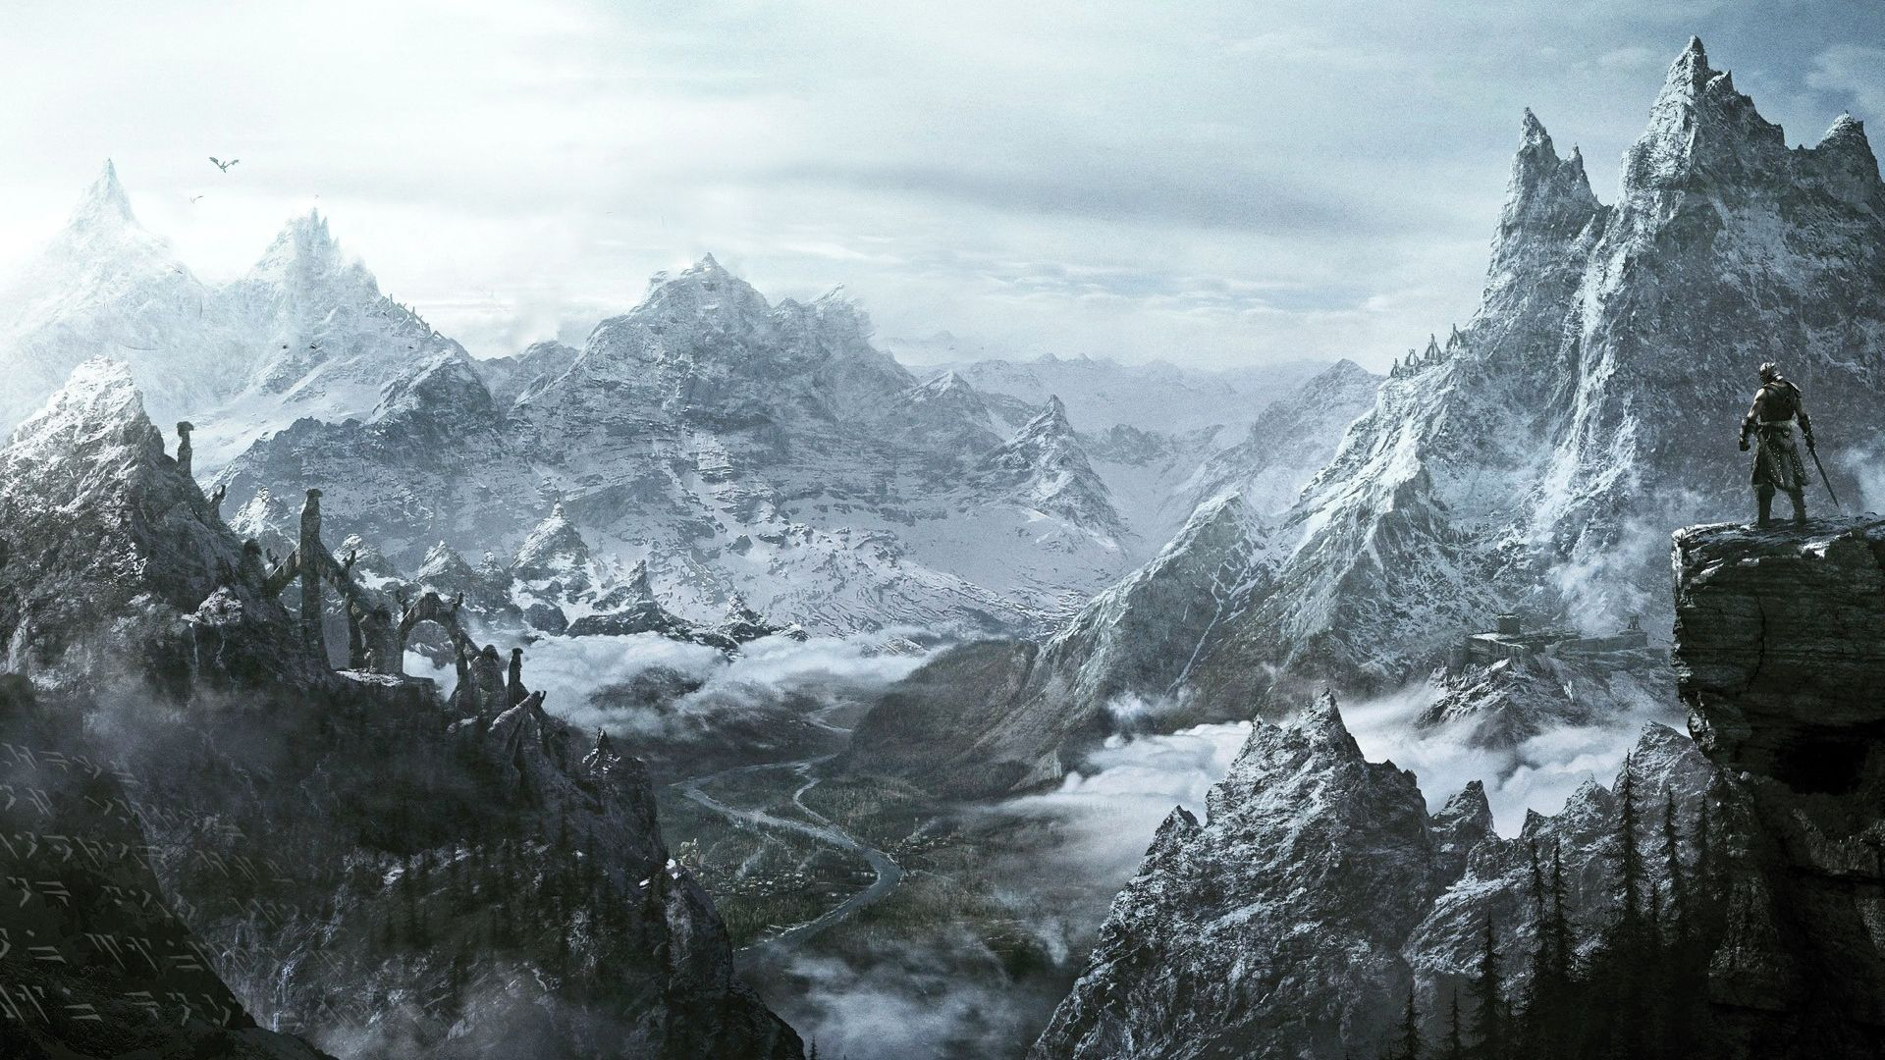
Motivation - Skyrim
Notes:
CGI of landscape
- E.G. Skyrim
Refer to image and show sides with light and

Slide 3
Statement of Problem

Slide 4
Statement of Problem

Slide 5
Statement of Problem

Slide 6
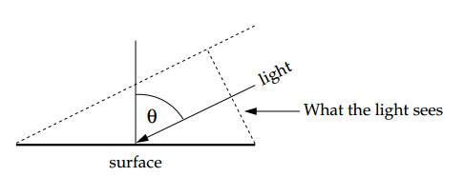
Deriving a solution

Slide 7

Final Equation
$$I= \frac{\cos{φ}\left(\frac{∂w}{∂x}\right)+\sin{φ}\left(\frac{∂w}{∂y}\right)}{\sqrt{{\left(∂w/∂x\right)}^{2}+{\left(∂w/∂y\right)}^{2}+1}}$$

Slide 8
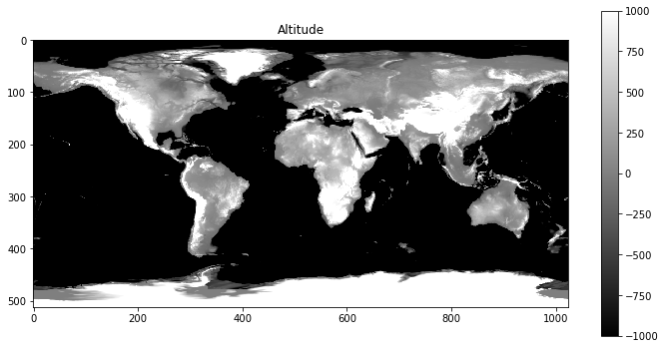
World Altitudinal Data

Slide 9
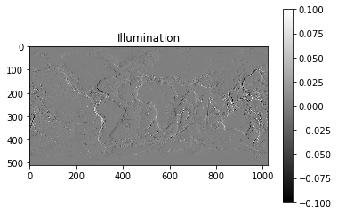

$$φ=0°$$

Slide 10
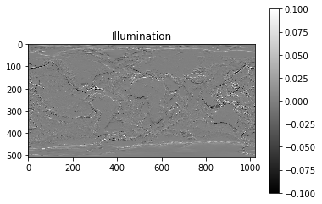

$$φ=90°$$

Slide 11
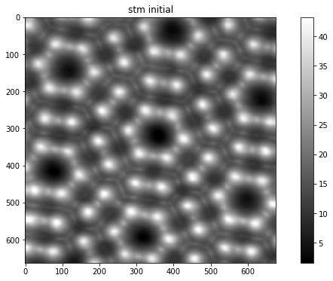
Scanning Tunneling Machine

Slide 12
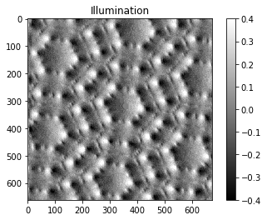
$$φ=0°$$

Slide 13
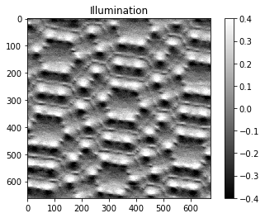
$$φ=90°$$

Slide 14
References
[1] M. Newman, Computational Physics, pp. 145-212, (2012).

